Slide 1
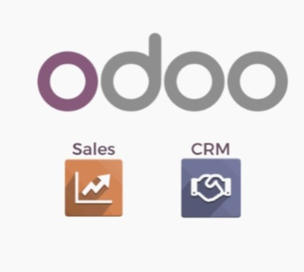
🔄
Enhance Communication in Odoo with the Message Post Function

Slide 2
CRM &Sales Process
Create Clients
Categorize Clients with tags feature
Create activity plan to cover and handle all sales men activities
Feedback Notes

Slide 3
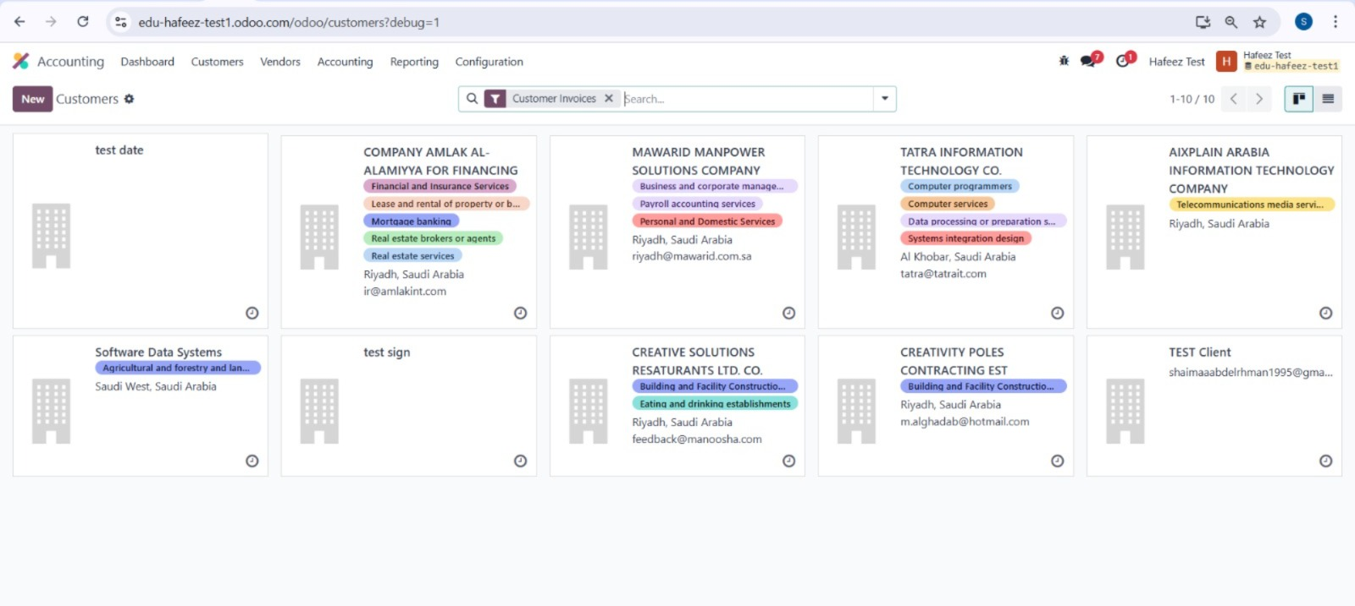
Create Clients

Slide 4
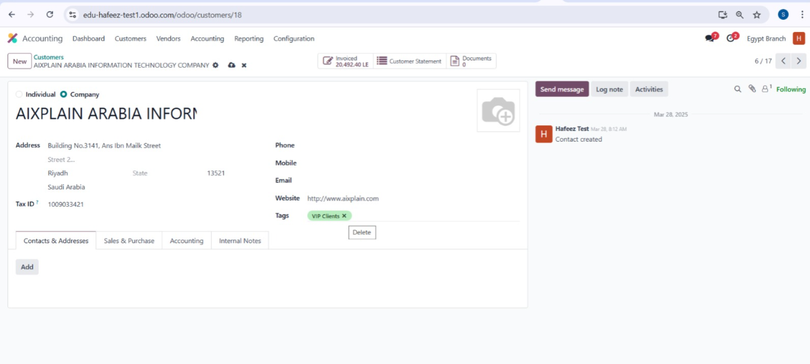
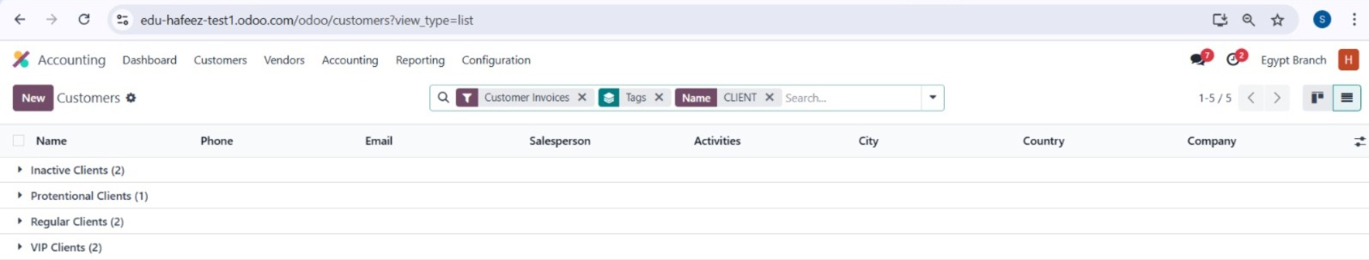
Tags Feature
Categorize Clients with tags feature

Slide 5
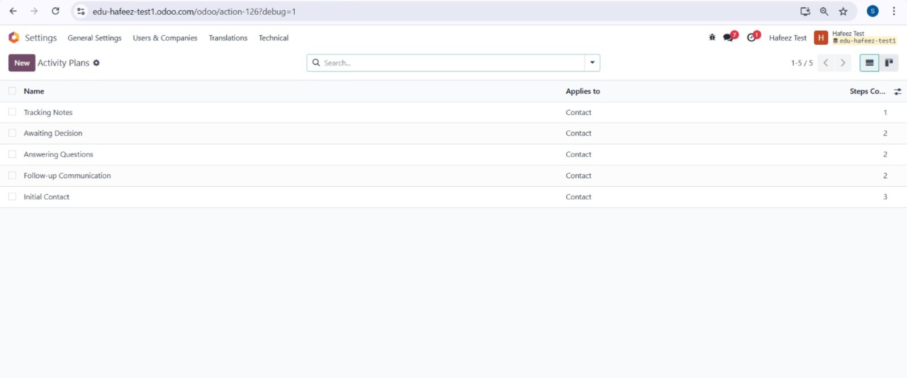
Develop and implement activity plans that encompass all workflow processes in alignment with your marketing plan

Slide 6
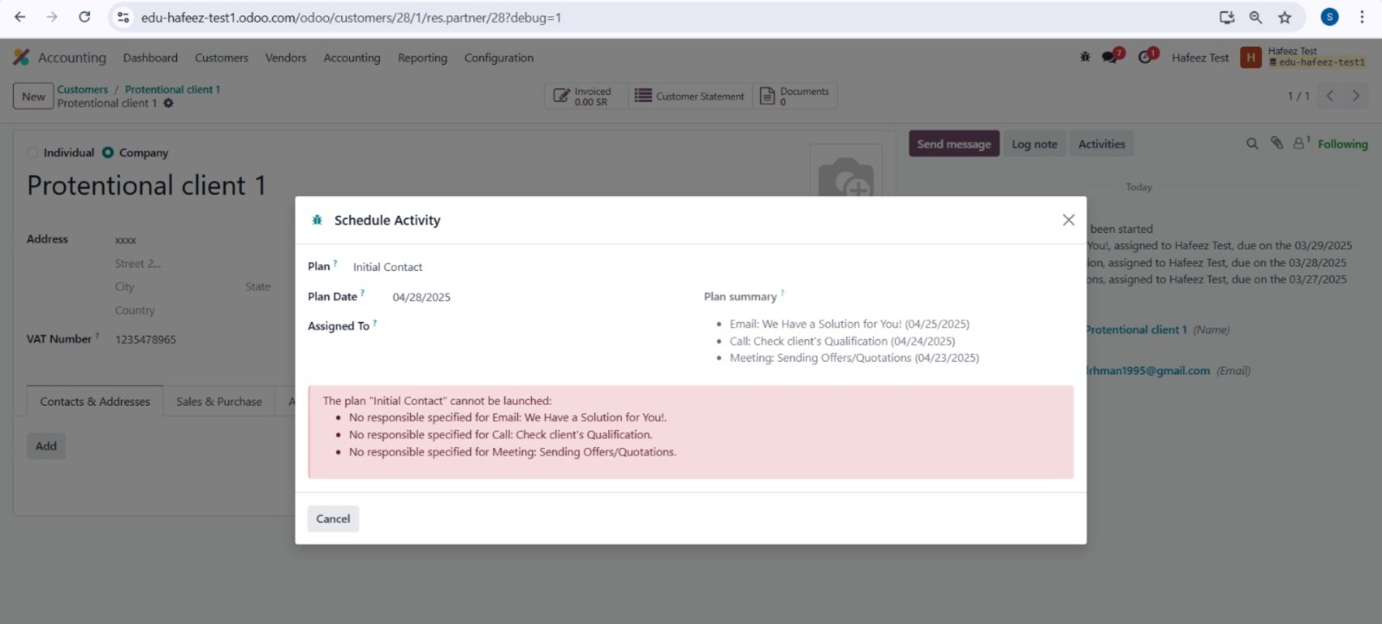
Use Log Notes and Activities inside Odoo Accounting

Slide 7
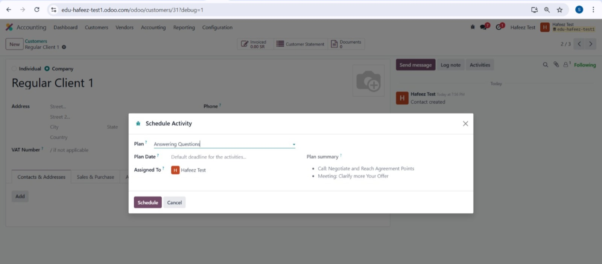
Lead Qualification

Slide 8
Sales Conversion

Slide 9
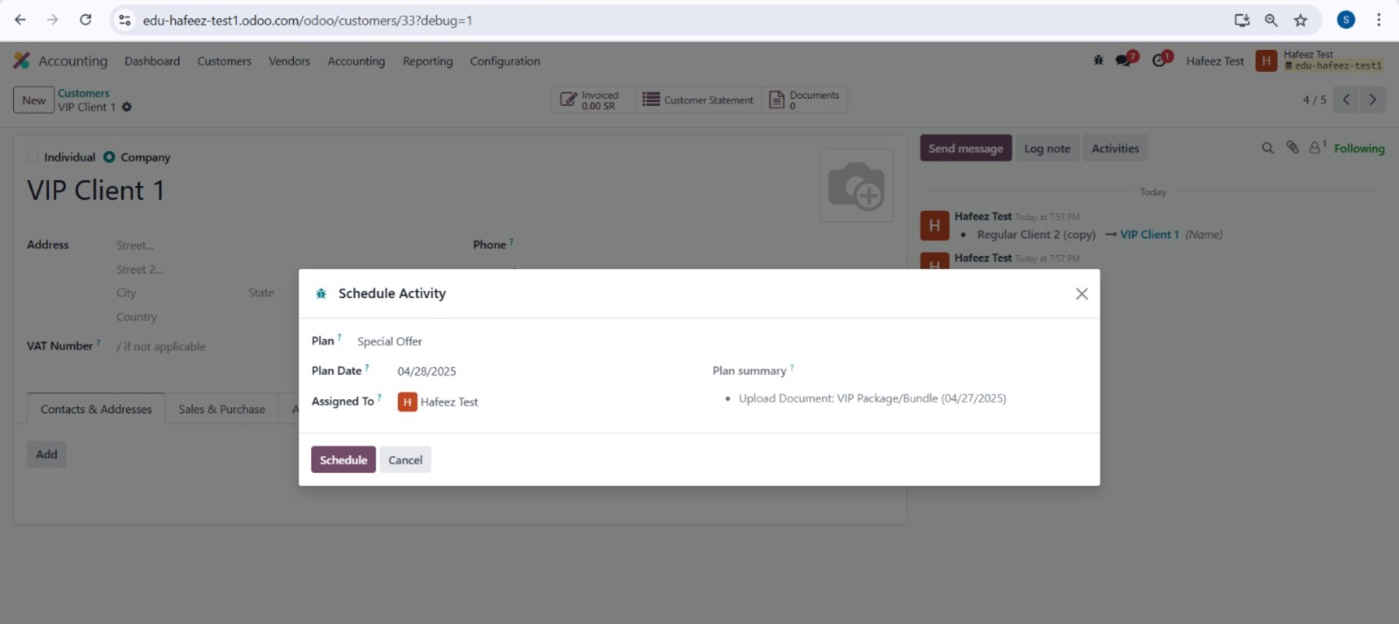

Slide 10
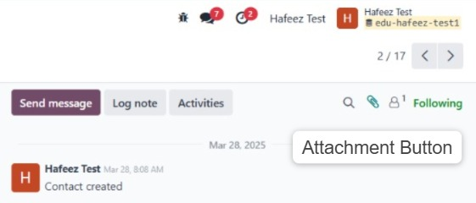
Smart replacement for Quotation and Documentation

Slide 11
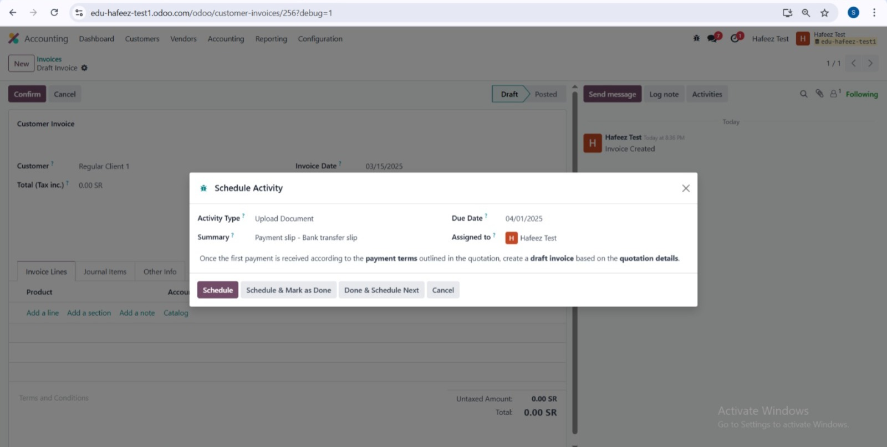

Slide 12
